Slide 1

The Snake AI
Vishnu Rohith Nanduri (VN212)
Yashwanth Reddy Kovvuri (YK291)
Department of Computer Science and Engineering
CSE 4633/6633 Introduction to Artificial Intelligence
Dr. Eric Hansen
2nd November 2023

Slide 2




OVERVIEW
Introduction
Prerequisites
Why Reinforcement Learning?
Reinforcement Learning Loop
Algorithm & Mechanism
Game Environment
Results
References

Slide 3

Introduction
The snake game includes the main elements and mechanism as follows:
Snake – It is main character of the game which is represented for collection of food. As it eats food, the snake grows its size.
Food Item – it is scattered all over the game board and usually shown as tiny, objects
The more the snake consumes the food, The size of snake grows that longer and gives a result of high score.
Game End – When the snake strikes any obstacles like itself.
The game is over when the Collision occurs when the snake collides with its own body.

Slide 4




Prerequisites
Required Libraries:
– Used to create and Train DQN neural network
– Used for Developing 2D games and helps to
design and manage the Game.
– Used for Numerical Computations and to
work with arrays.
Required Modules:
Random – Used for generating random numbers.
NN – Used for training and defining Neural Network.

Slide 5
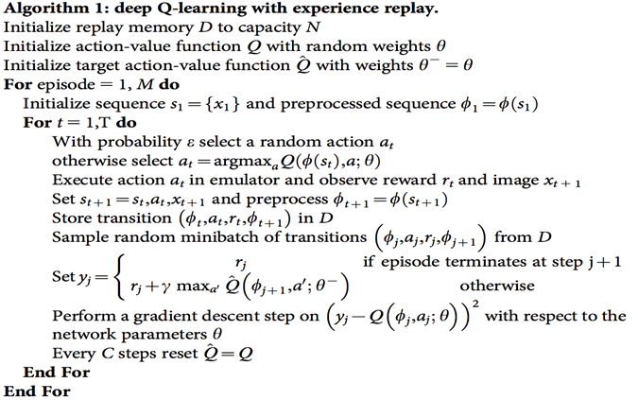

Why Reinforcement Learning?
Reinforcement Learning :
It is a machine learning approach that aims to train agents to maximize cumulative reward by making sequential choices in an environment. The main reason to select reinforcement Learning are :
Sequential decision making
Complex Environments
Reward optimization
Efficient exploration-Exploitation
Using Deep Q-Network(DQN) has advantages like:
Handling high-dimensional input
Memory and Experience Replay
Transfer Learning and Generalization
Deep Neural Network Approximation

Slide 6
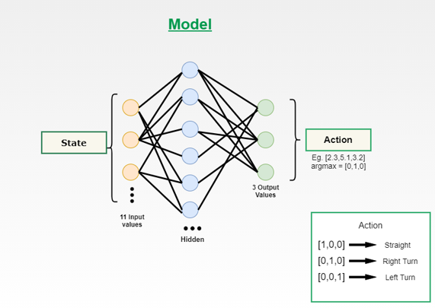

Reinforcement Learning loop : Agent, Environment, State, Action, Reward –
Agent : It is a decision-maker that interacts with surroundings and acts accordingly with the knowledge and policy that maximizes the cumulative reward over time.
Environment : It is an external system that is interacted by agent.
The laws and reactions to agent’s actions are defined by environment.
State : it is an illustration of environment’s current state which
has all the necessary information that agent requires to make actions.
Action : The action space is collection of all possible actions.
The agents learns from the experience to maximize the
cumulative reward by mapping states to actions.
[1,0,0] – Straight
[0,1,0] – right turn
[0,0,1] – left turn
Rewards : Rewards and penalties guide the agent’s learning process.
~ Eat Food : +10 ~ Else : 0
~ Game over : -10

Slide 7

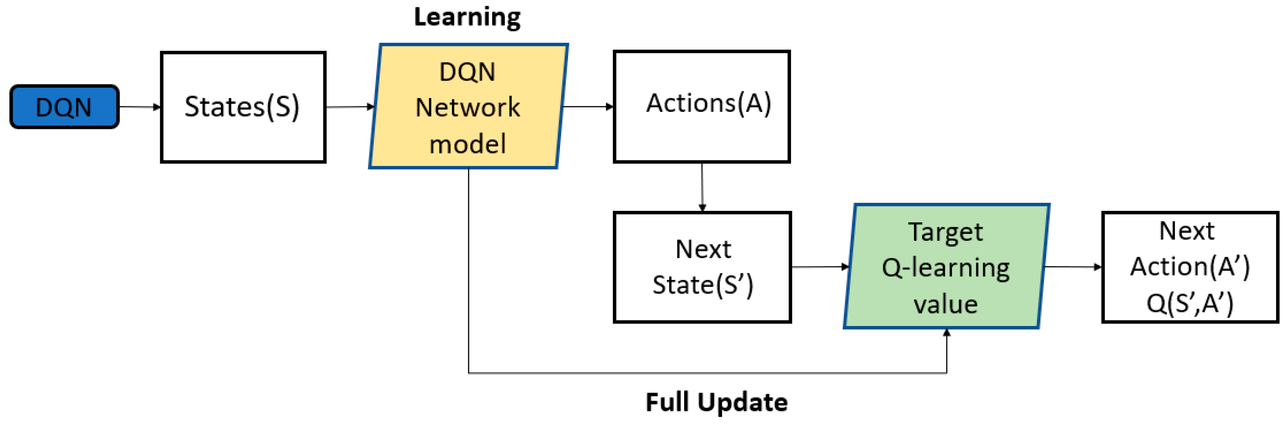


Algorithm & Mechanism
Initialize : The Q-values are randomly initialized
Exploration – Exploitation : AI chooses the actions based on Q-neural network in the training phase. Initially,
Random action are taken for exploration and later as training goes on, Gradually shifts to a greater reliance on
Q-Neural network.
Action, Execution and Reward : The selected actions in the environment are executed and the AI receives Rewards
Based on the interactions.
Update Q-values : The Bellman equation is used to update the Q-values following each action, taking into account
the reward that was received and projecting future rewards.
Replay memory : for every move performed, AI stores the Original
state, action, state, obtained reward, when the Game is ended. The
data stored in replay memory buffer will be used for training later.
Memory is divided into short memory and long memory.
Repeated Iterations : Until a certain event occurs, like the conclusion
of a game or a predetermined number of iterations, the AI keeps
repeating the above steps. The AI in the Snake Game can continuously
learn from and improve its strategies thanks to this iterative process.

Slide 8
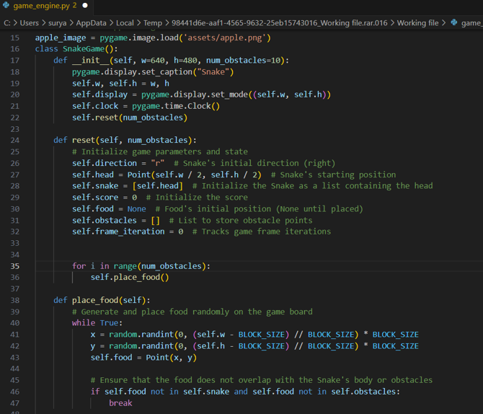
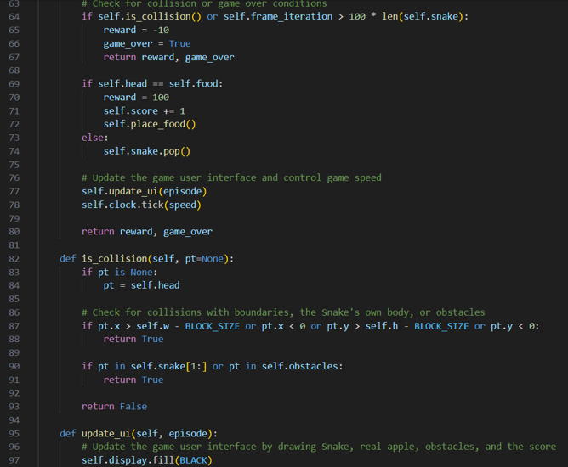
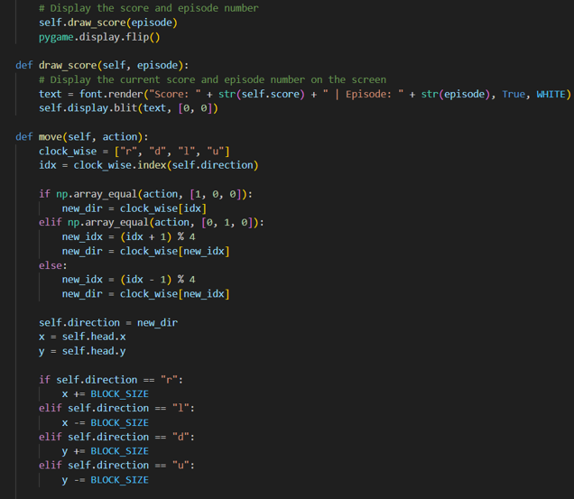

Game Environment

Slide 9


Results
Training :
By using reinforcement learning, we have trained the snake by using
Certain libraries like pytorch which plays episodes, choosing how to
Proceed each time to give a good cumulative reward. There is a training
Loop which involves resetting the game, engaging in episodes, obtaining
Rewards and refreshing agent’s memory.
For effective learning, The training is done for 1000 episodes.
Output :
As we can see, The snake grows in its size and the score increases when the snake consumes the food.
More Food > snake size > score
The game will be over once the snake collides itself and the final reward is given.

Slide 10

References
https://cs230.stanford.edu/projects_fall_2021/reports/103085287.pdf
https://www.researchgate.net/publication/351884746_A_Deep_Q-Learning_based_approach_applied_to_the_Snake_game

Slide 11

THANK YOU & Any Questions?

